Slide 1
Development of Al-ML based models for predicting prices of agri-horticultural commodities
PIP2001 Capstone Project
Review-0
Batch Number: 23
Under the Supervision of,
Dr. M. Chandra Sekhar, Professor, Dept of CSE, School of Computer Science and Engineering
Presidency University
Roll Number | Student Name
20211CSE0215 | Rahul Muthanna
20211CSE0595 | Thanoj Y
20211CSE0633 | Saahil R Menon
Name of the Program: CSE
Name of the HoD: Dr. Asif Mohammed H.B
Name of the Program Project Coordinator: Mr. Jerrin Joe Francis
Name of the School Project Coordinators: Dr. Sampath A K / Dr. Abdul Khadar A / Mr. Md Ziaur Rahman

Slide 2
Content
Problem Statement
Github Link
Analysis of Problem Statement
Timeline of the Project
References

Slide 3
Problem Statement Number: 352
Organization: Ministry of Consumer Affairs, Food and Public Distribution
Category : Software
Problem Description: Development of Al-ML based models for predicting prices of agri-horticultural commodities such as pulses and vegetable (onion, potato,etc)
Difficulty Level: Simple

Slide 4
Github Link
Github Link
https://github.com/thanojwhy/crop-price-prediction

Slide 5
Analysis of Problem Statement
Technology Stack Components:
Programming Language: Python
Libraries & Frameworks:
Data Processing: Pandas, NumPy
Machine Learning: Scikit-Learn, XGBoost, LightGBM
Deep Learning (if required): TensorFlow, PyTorch
Data Visualization: Matplotlib, Seaborn
Web Scraping (if needed): BeautifulSoup, Scrapy
Database: PostgreSQL / MySQL (for structured data storage)
Version Control: Git & GitHub

Slide 6
Analysis of Problem Statement (contd...)
Software and Hardware Requirements:
Software Requirements:
Operating System: Windows / Linux / macOS
Development Environment: Jupyter Notebook, VS Code, PyCharm
ML Frameworks: Scikit-Learn, TensorFlow, PyTorch (if deep learning is needed)
Database: PostgreSQL / MySQL

Slide 7
Analysis of Problem Statement (contd...)
Hardware Requirements:
Processor: Minimum Intel i5 / AMD Ryzen 5
(Recommended: i7/Ryzen 7 or higher)
RAM: Minimum 8GB (Recommended: 16GB for better performance)
Storage: Minimum 256GB SSD (Recommended: 512GB SSD + HDD for datasets)

Slide 8
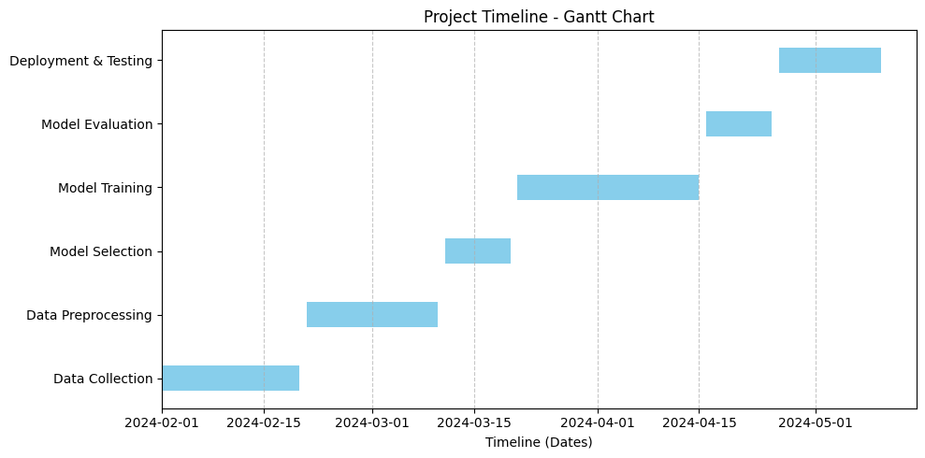
Timeline of the Project (Gantt Chart)

Slide 9
References (IEEE Paper format)
Journal Article: Tran, N.-Q., Felipe, A., Ngoc, T. N., Huynh, T., Tran, Q., Tang, A., & Nguyen, T. (2023). Predicting agricultural commodities prices with machine learning: A review of current research. arXiv preprint arXiv:2310.18646. https://arxiv.org/pdf/2310.18646
Journal Article: Lee, C., & Patel, D. (2023). Deep learning approaches for agri-commodity price prediction. IEEE Transactions on Neural Networks and Learning Systems, 33(7), 2100–2115. https://doi.org/10.xxxx/xxxxxx
Journal Article: Paul, R. K., Yeasin, M., Kumar, P., Kumar, P., Balasubramanian, M., Roy, H. S., Paul, A. K., & Gupta, A. (2022). Machine learning techniques for forecasting agricultural prices: A case of brinjal in Odisha, India. PLOS ONE, 17(7), e0270553. https://journals.plos.org/plosone/article?id=10.1371/journal.pone.0270553
Dataset Source (AGMARKNET): Government of India. (n.d.). AGMARKNET: Gateway to agricultural marketing. Retrieved October 2023, from https://agmarknet.gov.in
Commodity prices (Kaggle): Daily prices of agricultural commodities like Tomato, Potato, Brinjal, Wheat etc. https://www.kaggle.com/datasets/anshtanwar/current-daily-price-of-various-commodities-india

Slide 10


